Slide 1
Detection of B-Type Natriuretic Peptide (BNP) with Flexible Biosensors for Cardiovascular Risk Assessment
Seth So

Slide 2
Sections
Key Concepts
Biosensors, Principles, Sensing
Fabrication
Processes & Materials, Process, PANI Synthesis, Final
Characterization
Setup, Specificity and Sensitivity, Debye Screening, Hemolysis, Flexibility and Restoration
Testing and Analysis
Human Serum, Healthy vs. Unhealthy, Data Classification
Future Work and Summary

Slide 3
Key Concepts

Slide 4
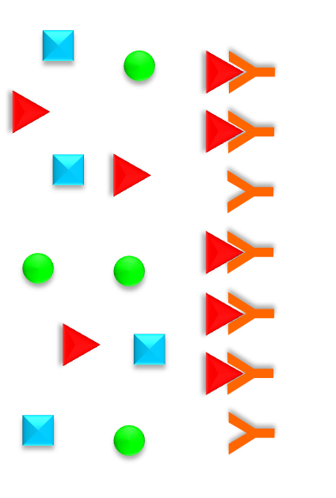
Biosensors
Analyte
Bioreceptor
Transducer
Enzymes
Proteins
Antibodies
DNA
Optical
Mechanical
Electrical
Measurable Signal
Biomolecule/Chemical Identification
Surface Modification and Entrapment
Antibody and Antigen Bindings
Qualitative and Quantitative

Slide 5
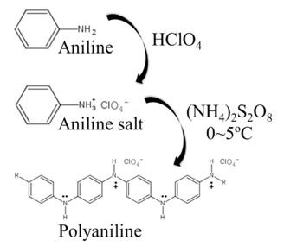
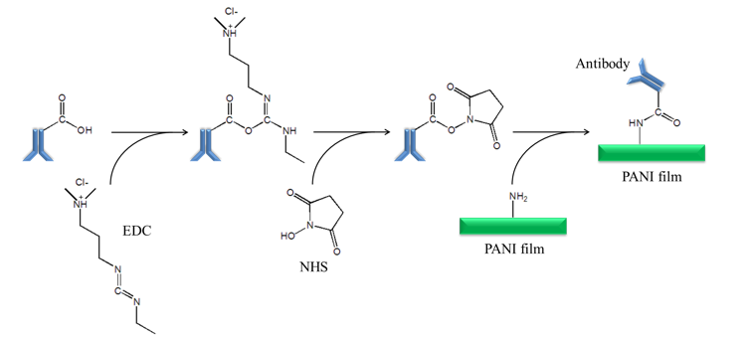
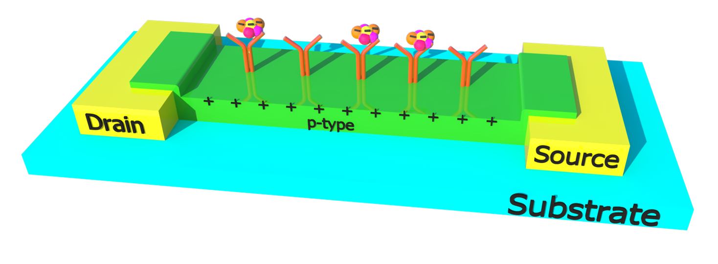
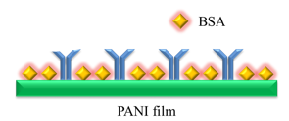
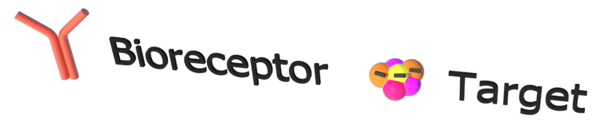
Working Elements
PANI Synthesis
P-type semiconductor
Chemical Polymerization
Surface Modification
Crosslinkers
Immunoassay Specificity
Conduction
Amperometric/Conductometric
Immunoassay Sensitivity

Slide 6
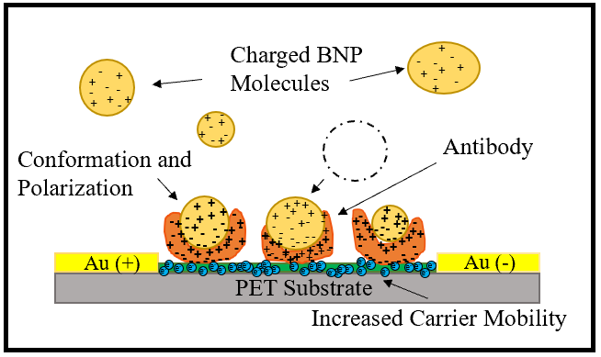
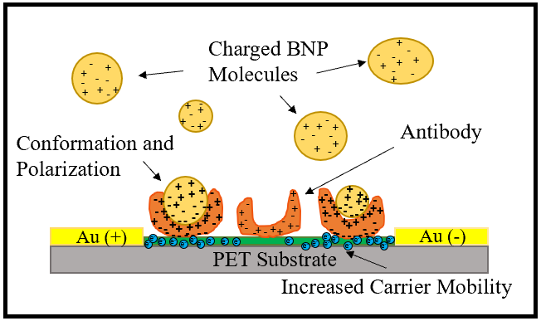
Sensing mechanism
Ion Sensitive Field Effect Transistor (ISFET)
Solution acts as gate electrode
[C] acts as gate voltage

Slide 7
Fabrication

Slide 8
Processes and Materials
Cleaning: Acetone, IPA, DI water, N2 gas
Photolithography: LOR-b, SC1827
Deposition: Chromium, Gold
PANI Synthesis: Aniline [C₆H₅NH₂], APS [(NH₄)₂S₂O₈], Perchloric Acid [HClO₄]
Surface Modification: EDC [C₈H₁₇N₃], NHS [C₄H₅NO₃], BSA, 0.01x PBS, Mouse BNP mAb, Recombinant Human BNP

Slide 9
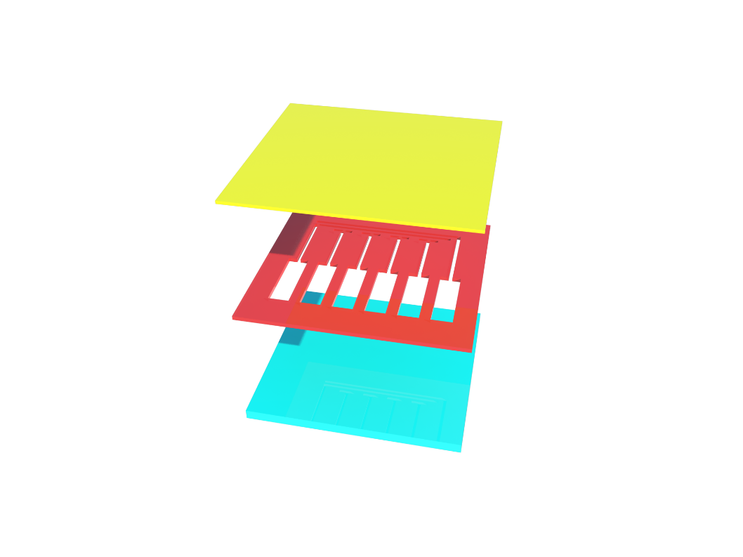
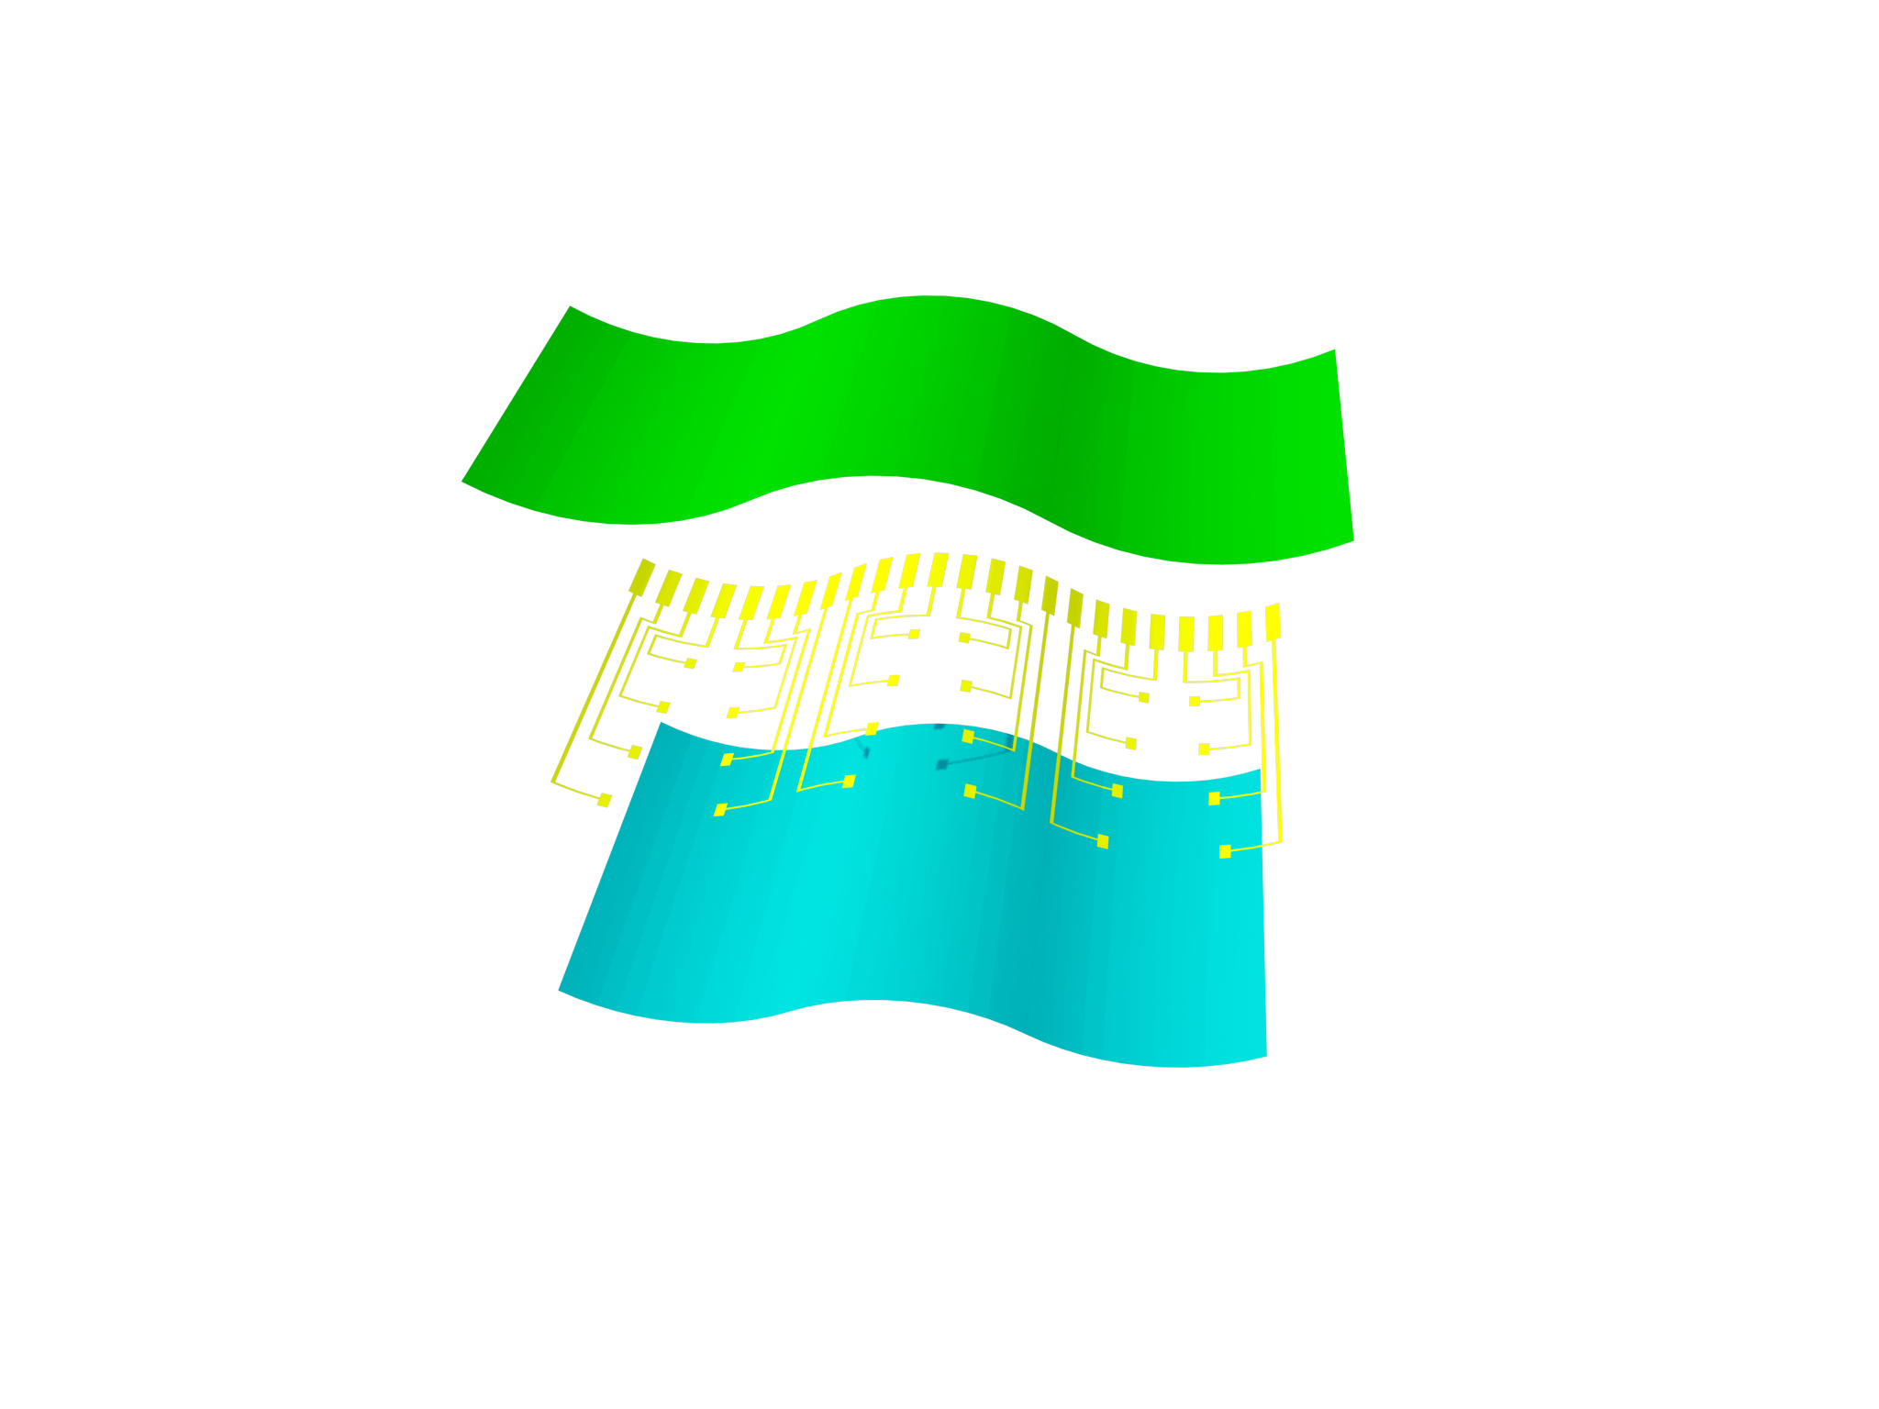
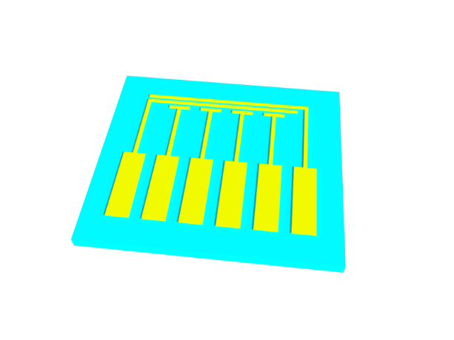
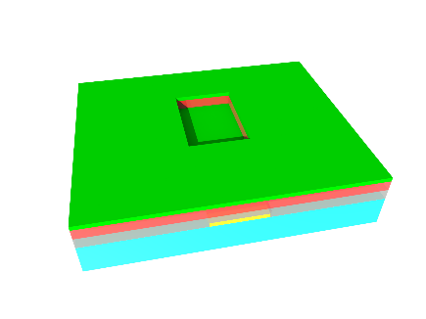
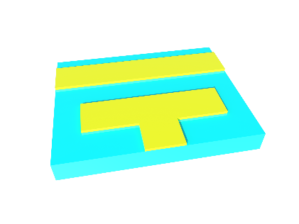
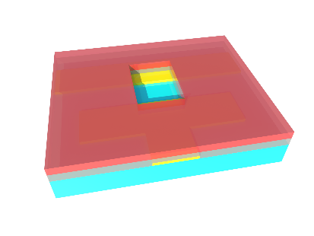
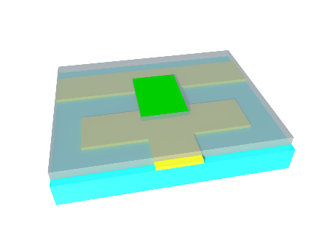
Device Fabrication Process
Sensing material
Electrodes
Flexible substrate
PET
Photoresist
PANI
Gold
LOR

Slide 10
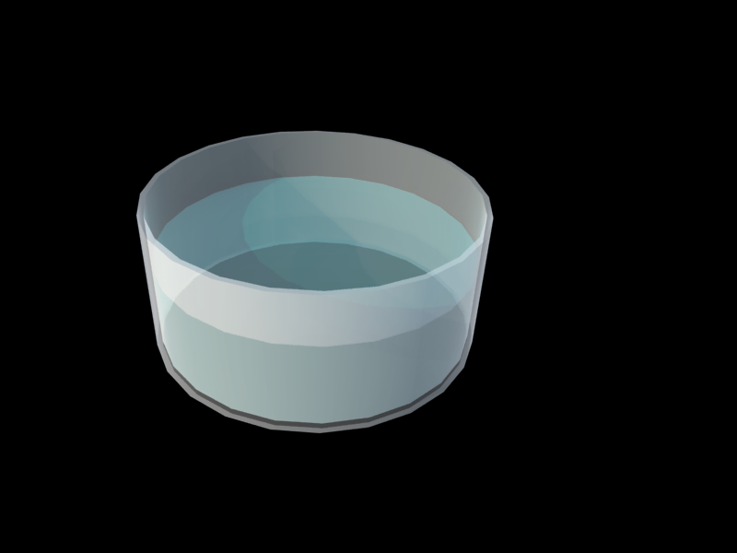


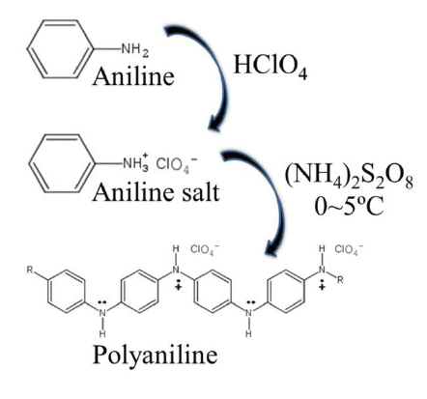
PANI Synthesis
1. Nucleation sites form on submerged substrate
Step 1
+
Substrate
Ice bath (0~5ºC)
2. Polymerization begins with protonization of oxidant
pH ~ 7
Step 2
Aniline
APS (oxidant)
+
3. Reaction is complete after ~90minutes.
Ice bath (0~5ºC)
pH < 1
Aniline + APS
HClO₄ (protonization)

Slide 11
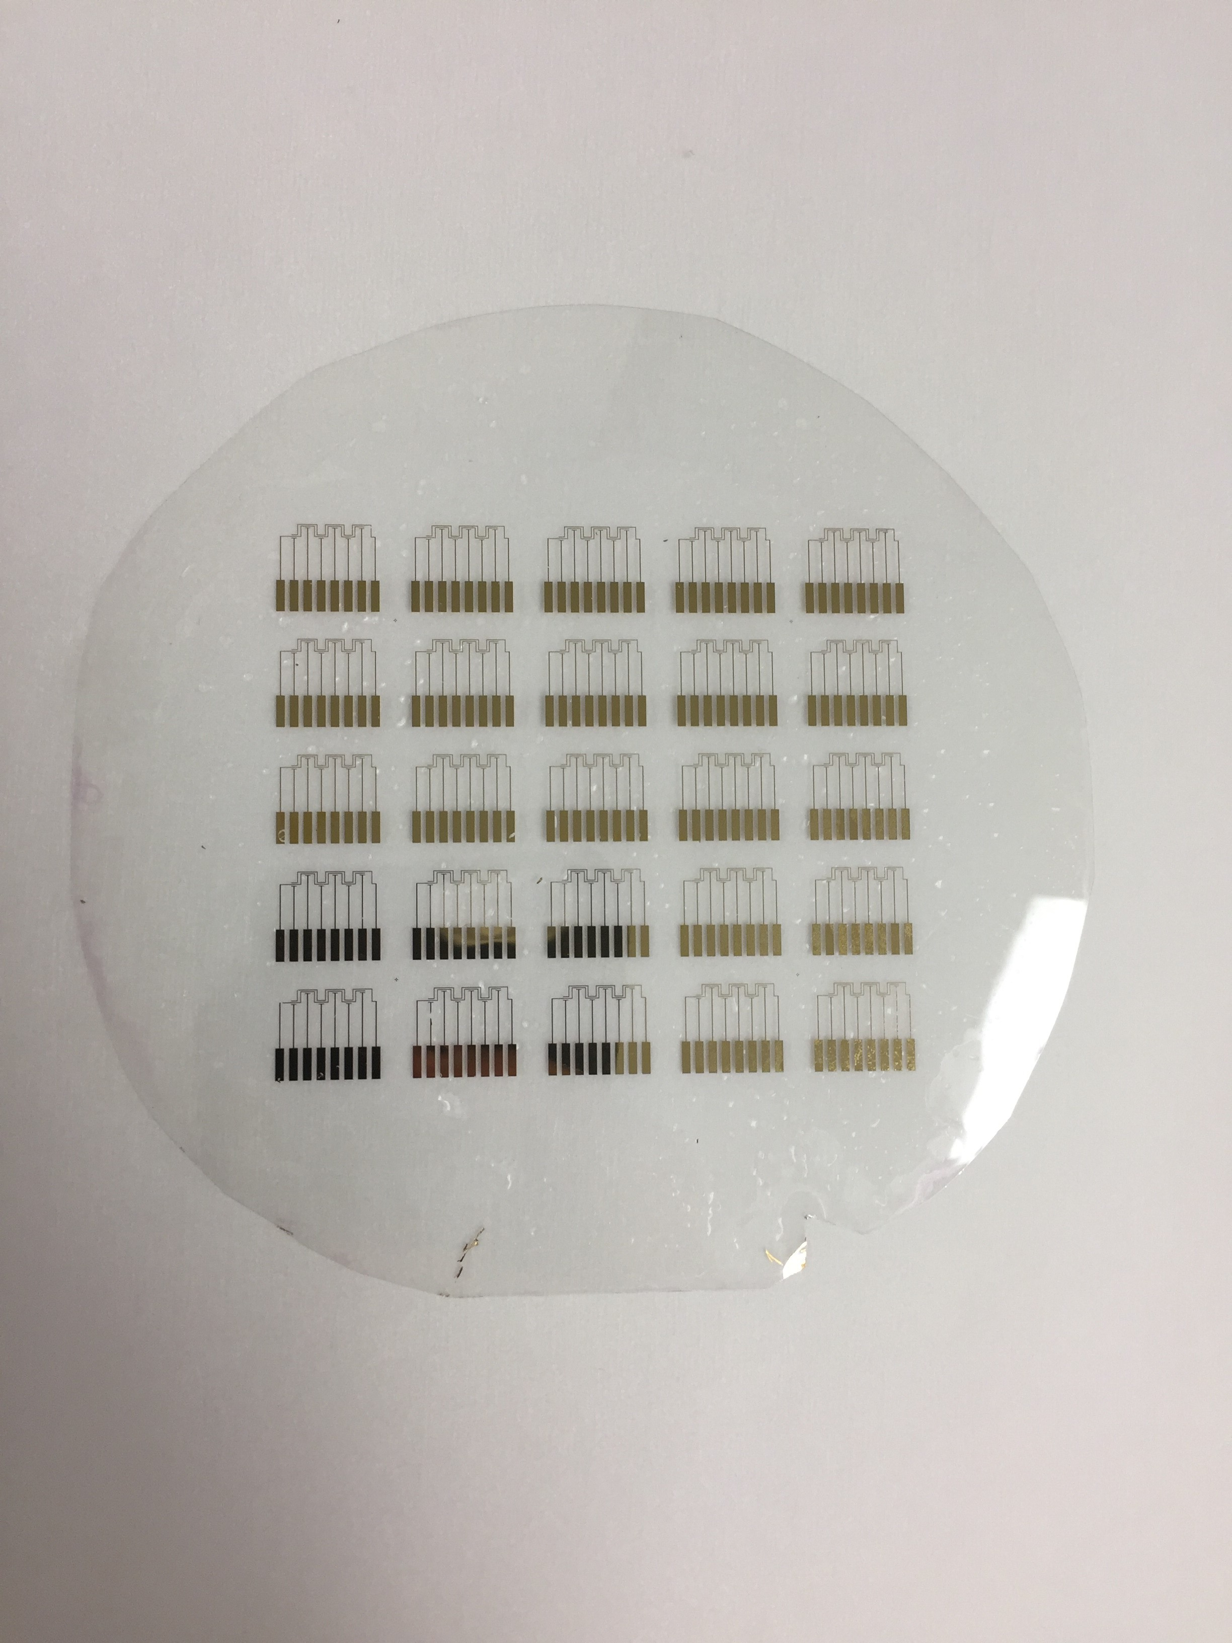
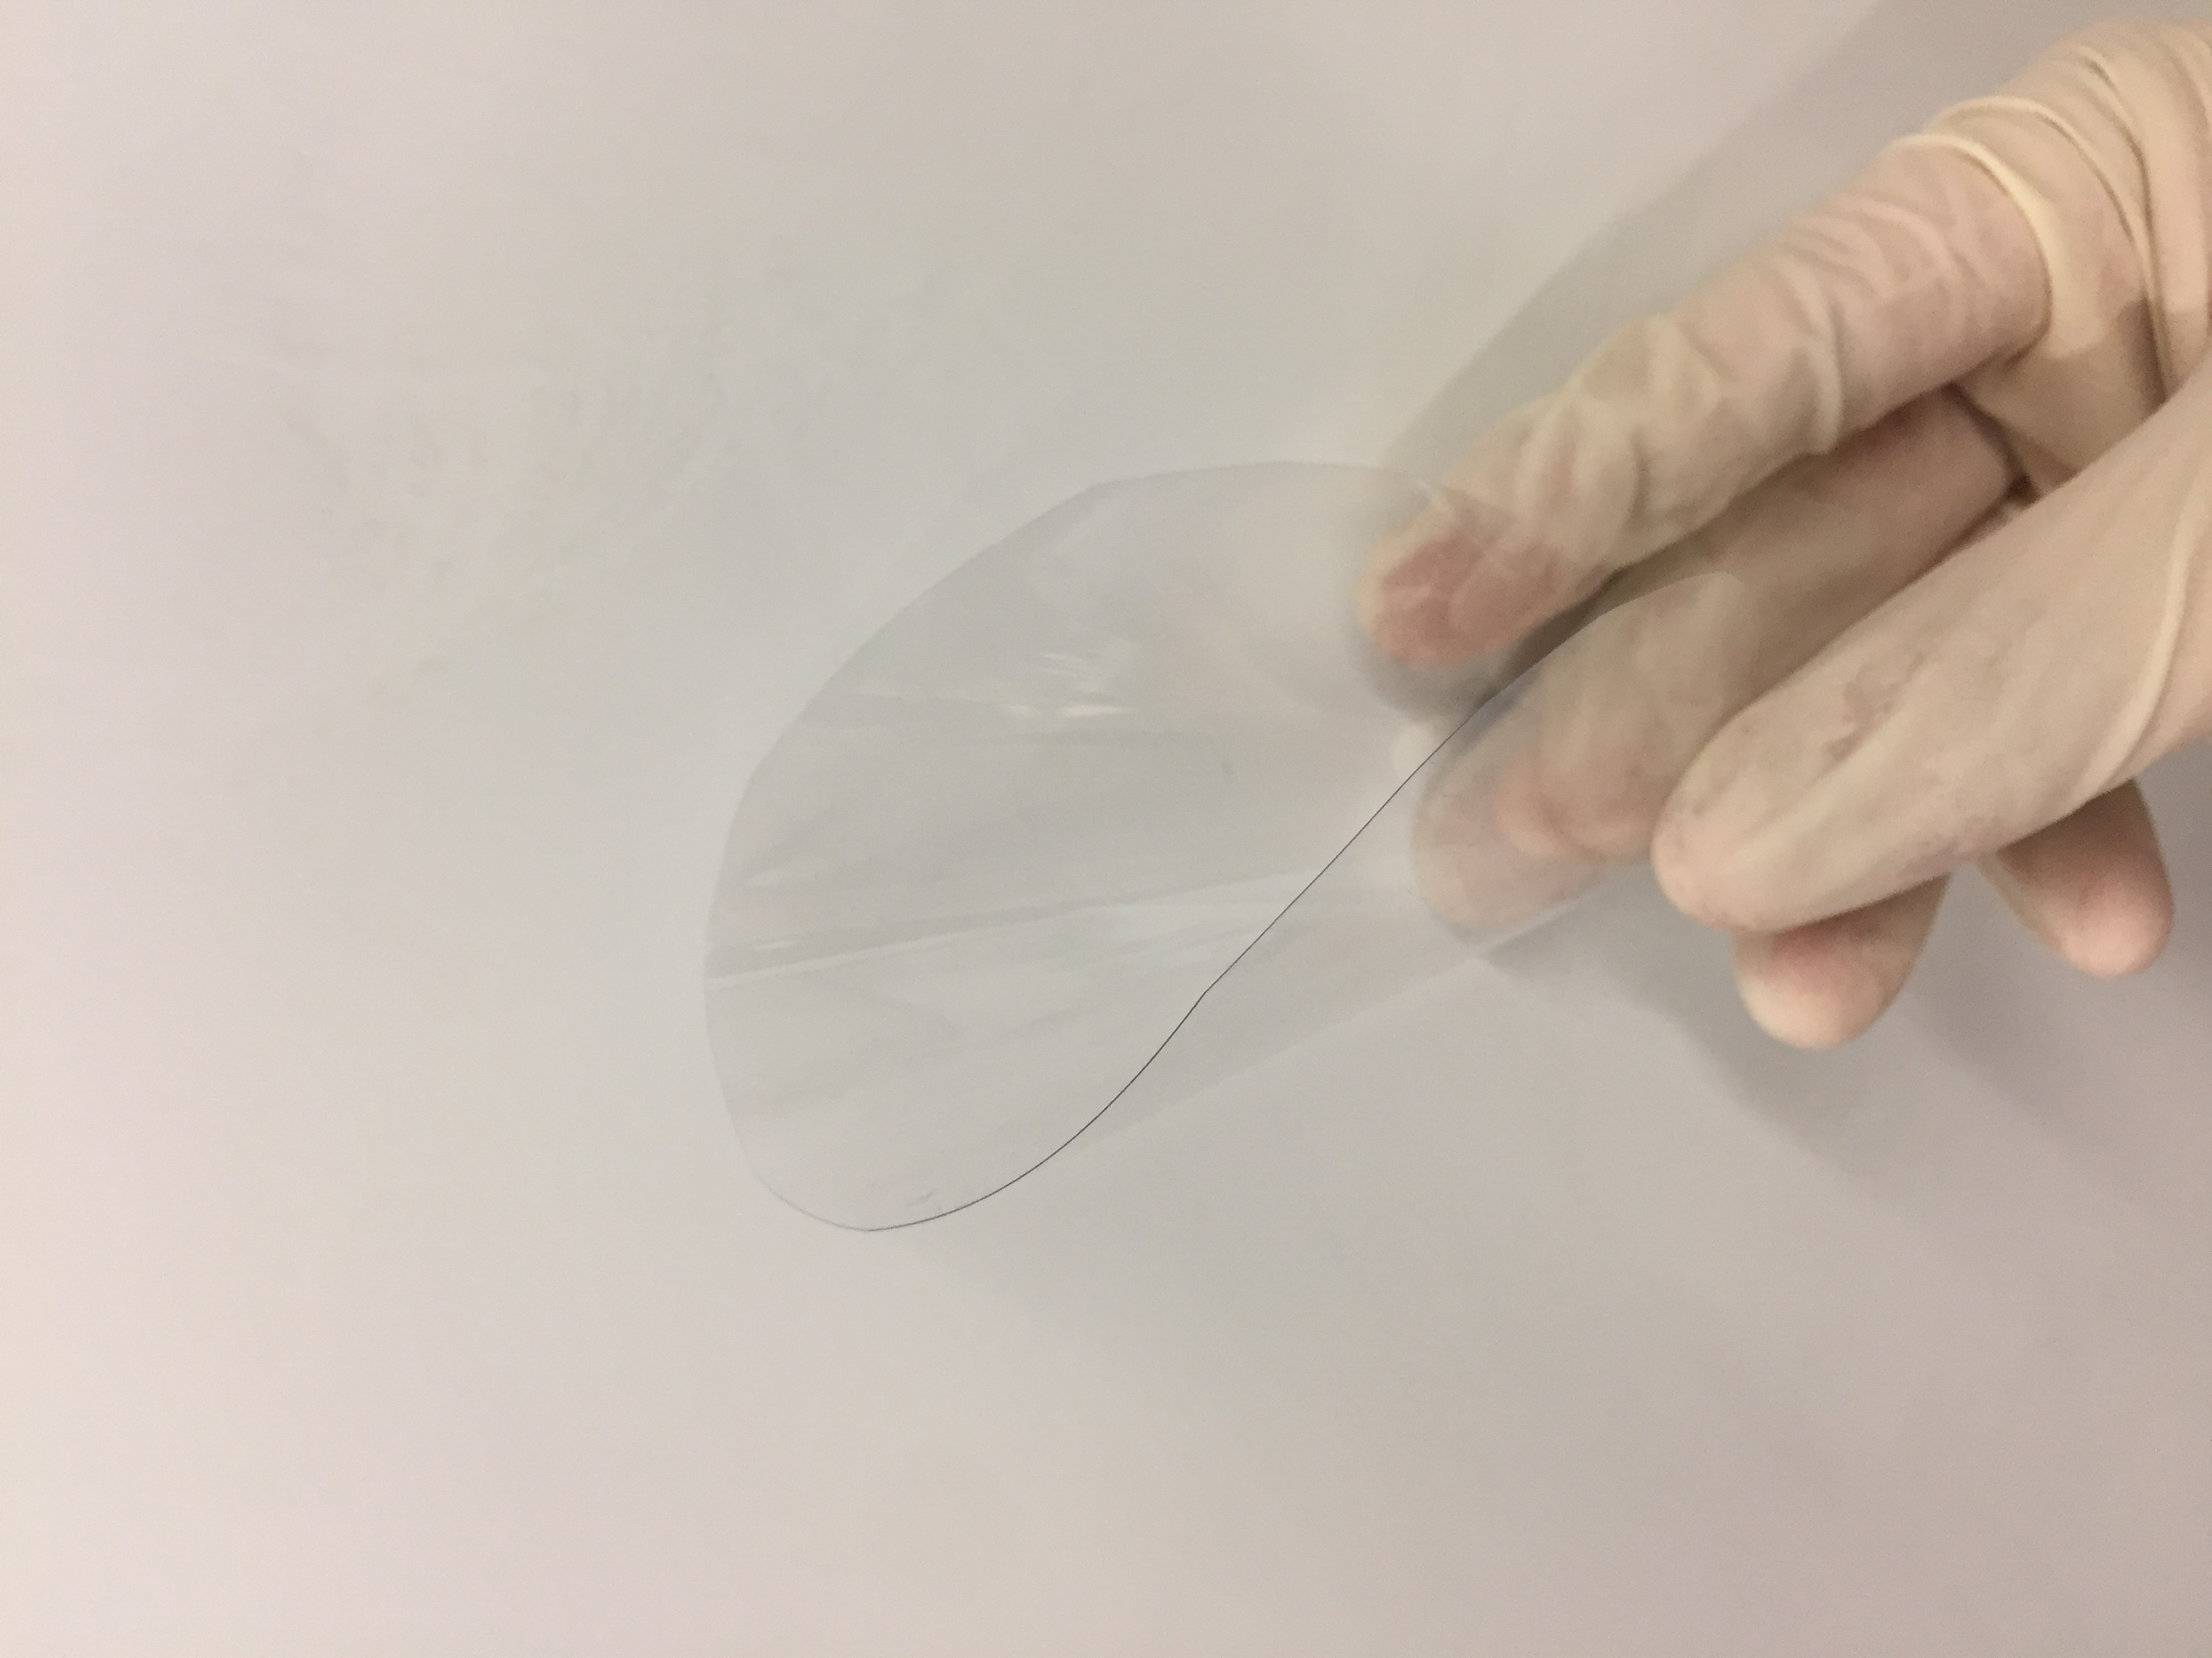
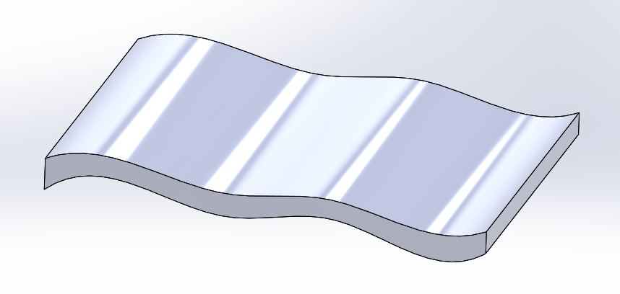
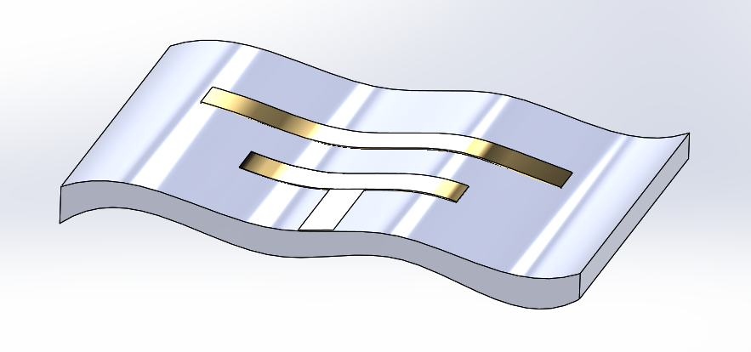
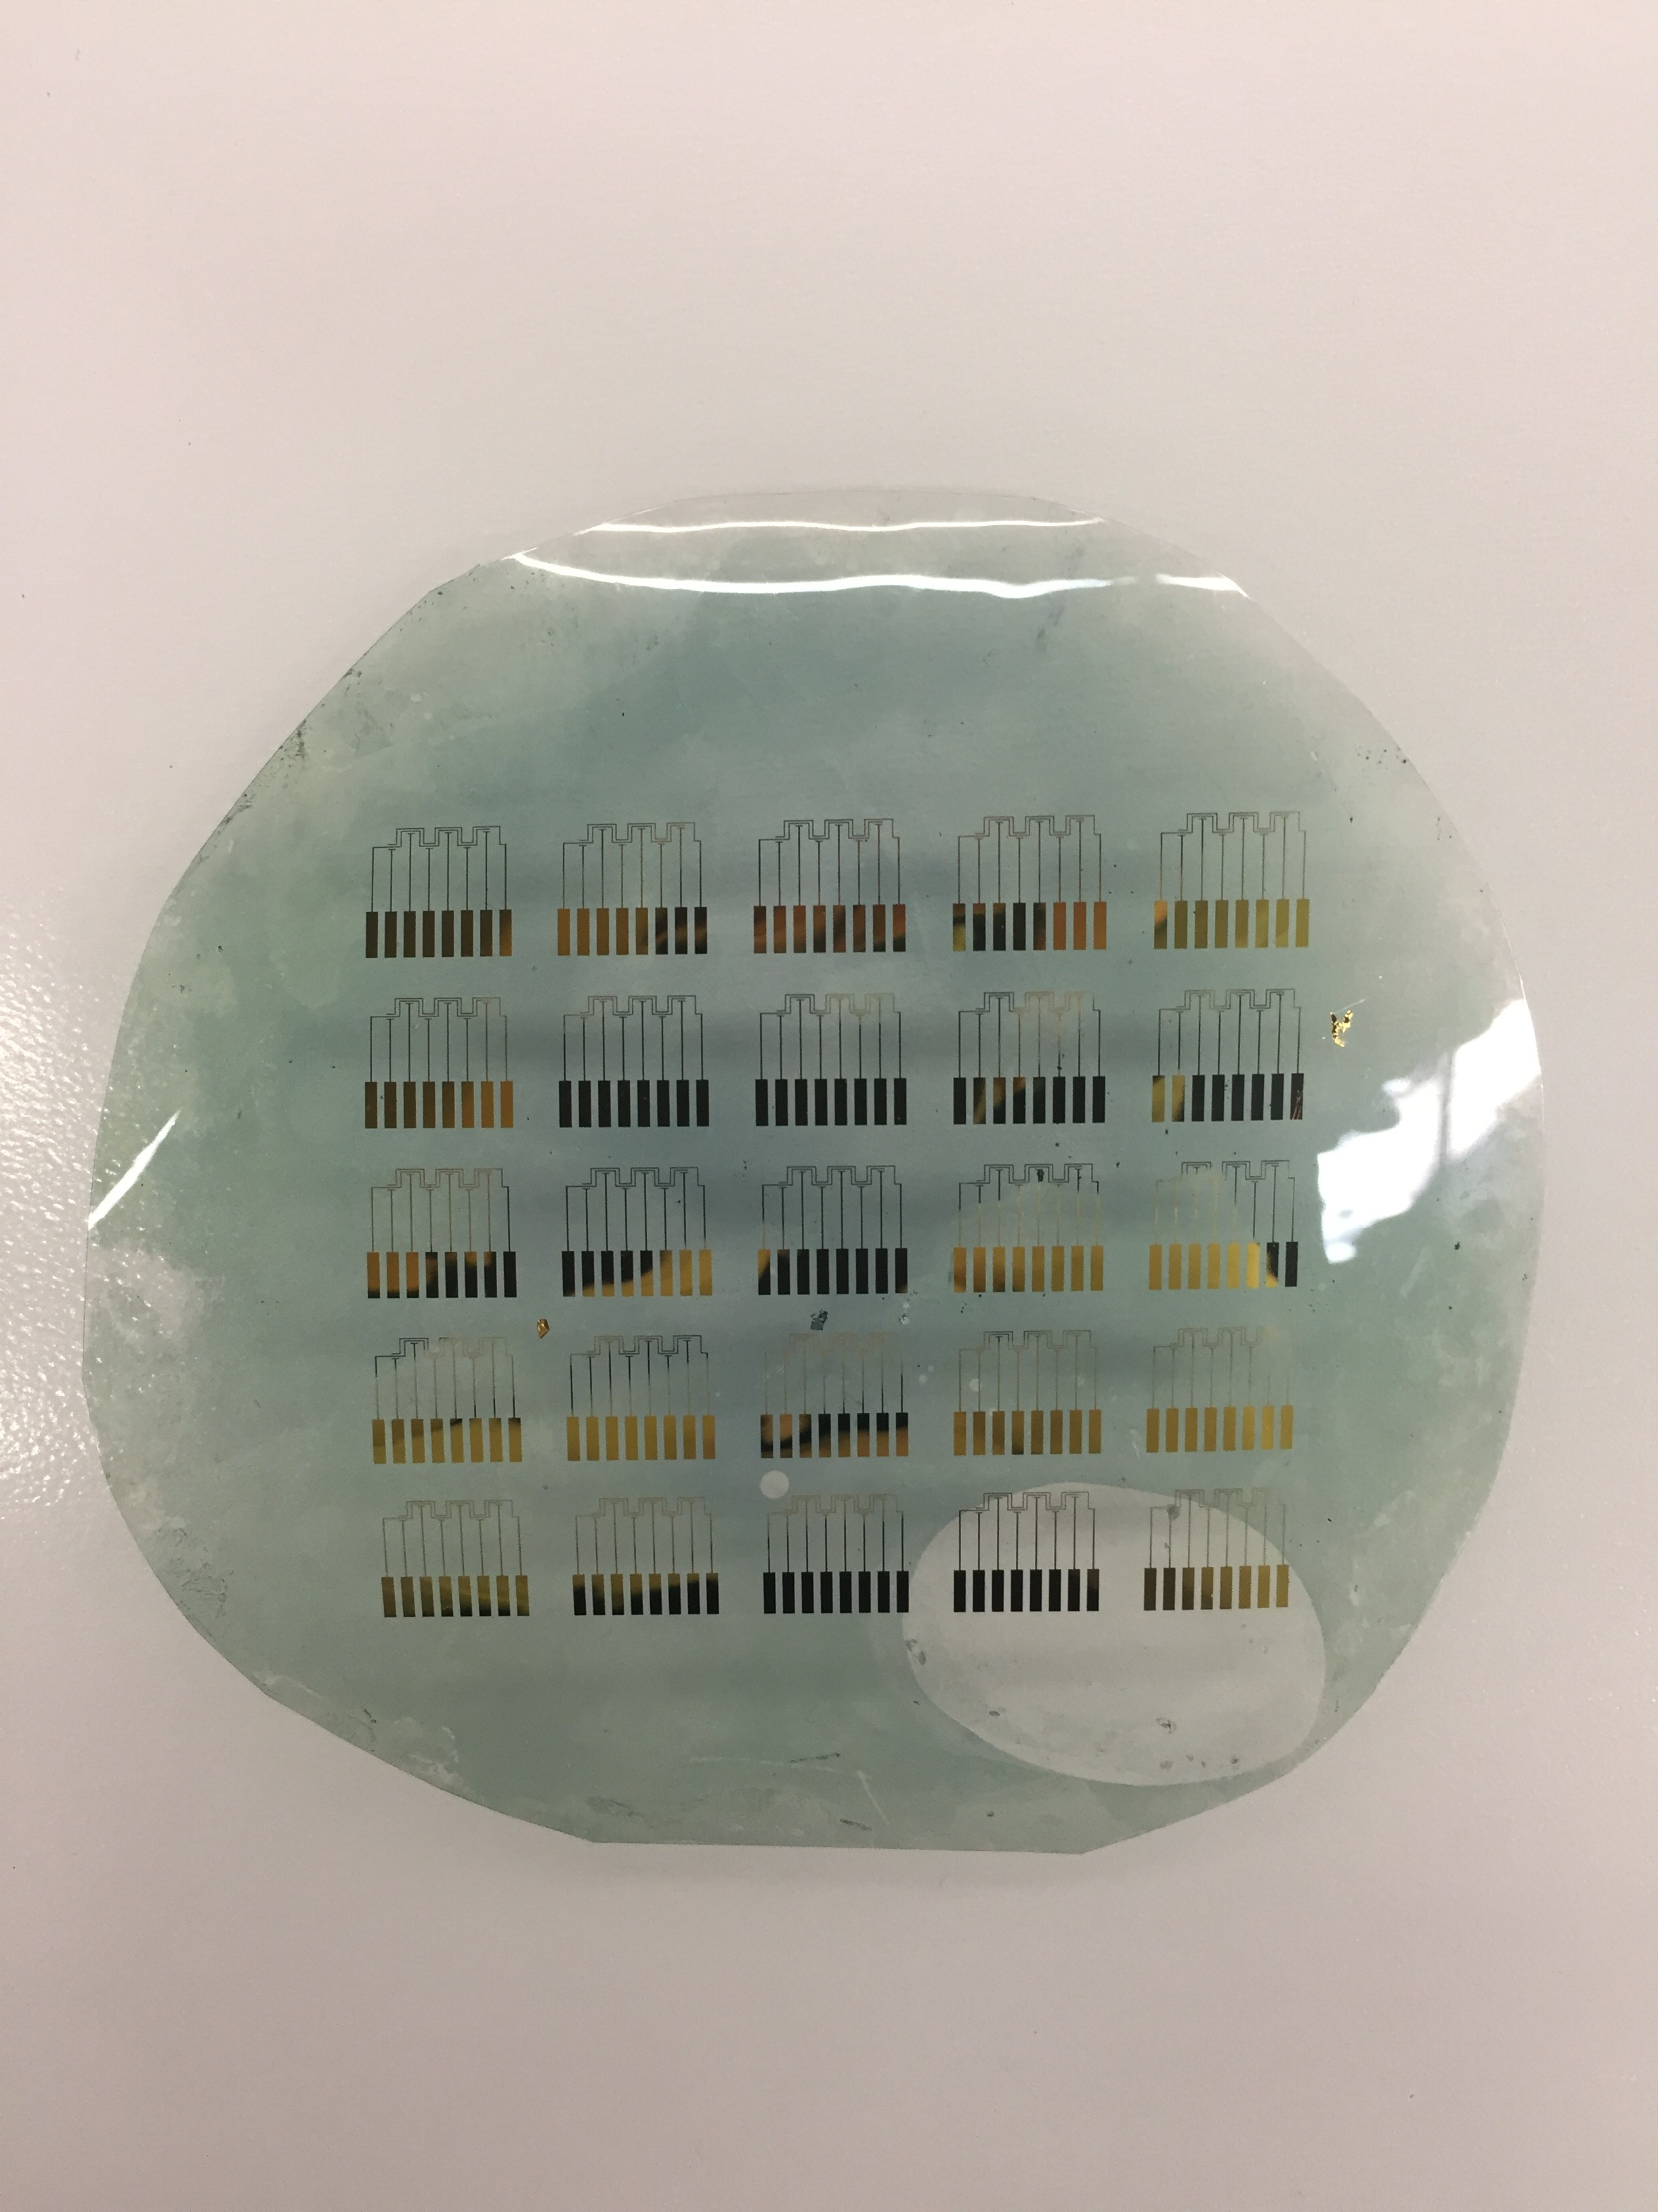
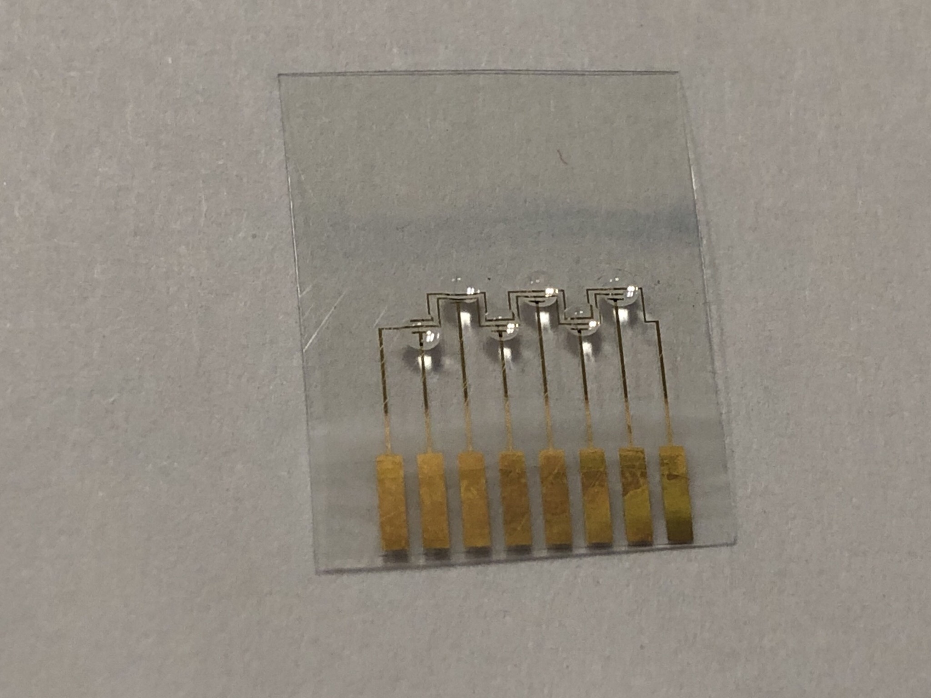
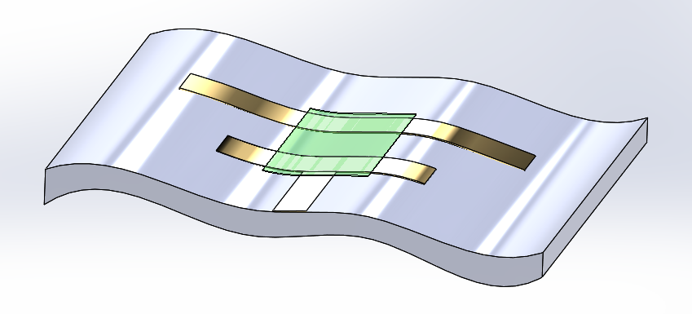
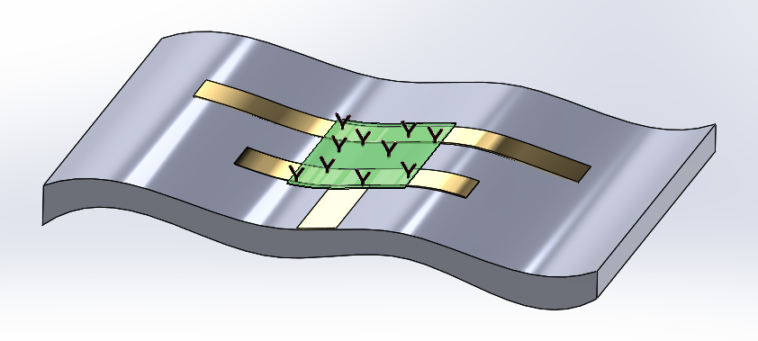
CAD to Physical
Lithography and Deposition
PET substrate is flexible, sturdy, and chemically stable
Lithography and Chemical Synthesis
Gold contacts and electrodes are highly conductive and biocompatible
Surface Modification and BSA Blocking
PANI is chemically synthesized across the electrodes to act as P-type semiconductor
Surface is modified with anti-BNP for 16 hours and blocked with BSA
Notes:
Useful in Prognosis
Poor prognosis typically consistent with higher blood concentrations
Normal concentration: <100pg/mL, grey 100-800pg/mL, high 1000pg/mL

Slide 12
Characterization

Slide 13
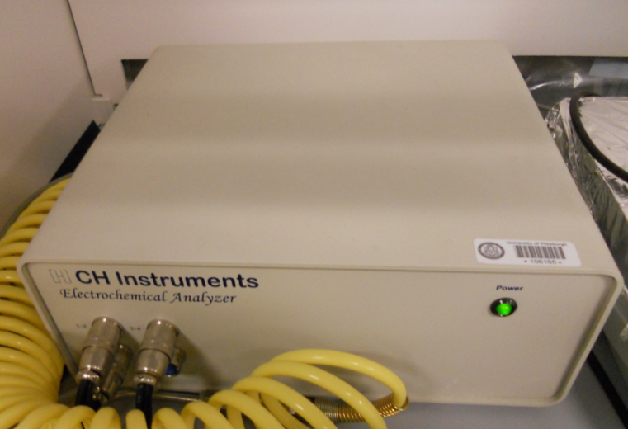
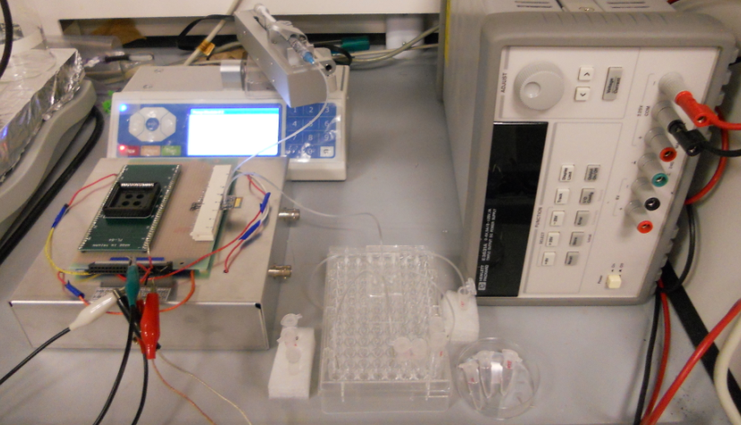
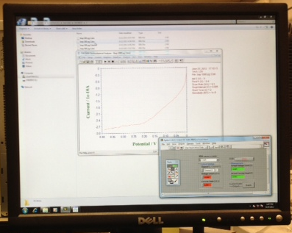
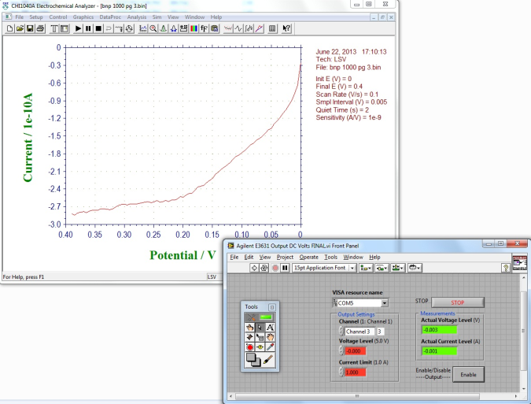
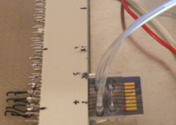
Biosensor Test System
Syringe pump
Gate power
supply
Potentiostat
Test circuit
Multiple inlets
Data Acquisition
Biosensor Chip
User Interface

Slide 14
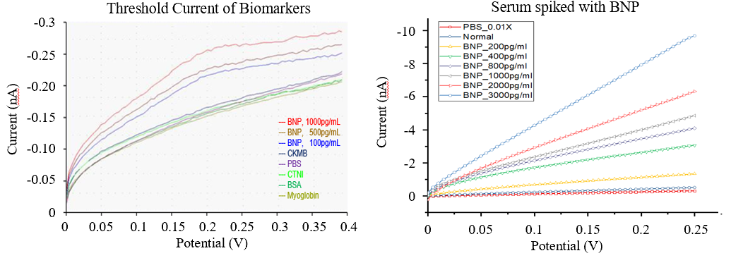
Data Representation
Purpose of Test – includes types of samples
Current Response – magnitude directly proportional with [C]
Legend – variable concentrations and samples
Voltage Sweep – from 0V – 0.4V

Slide 15
Specificity and Sensitivity
BNP showed the strongest electrical response out of the cardiac biomarkers
Device displayed wide range of sensitivity
Linear and Saturation regions

Slide 16
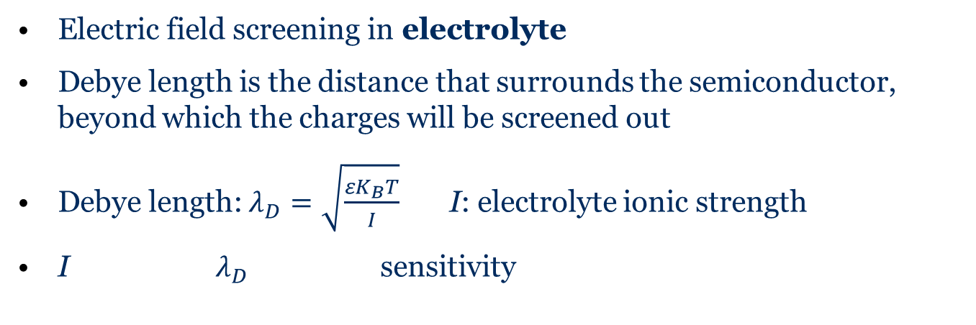
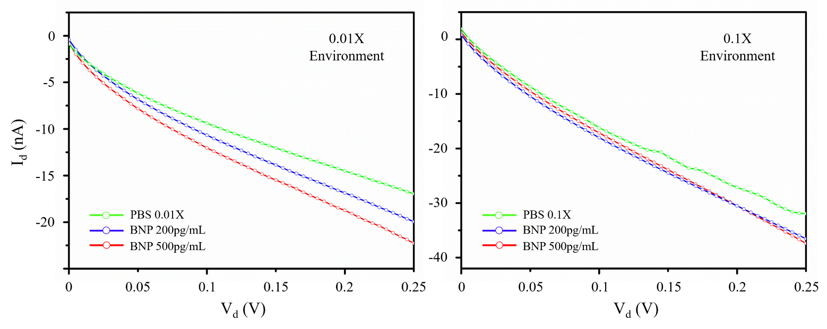

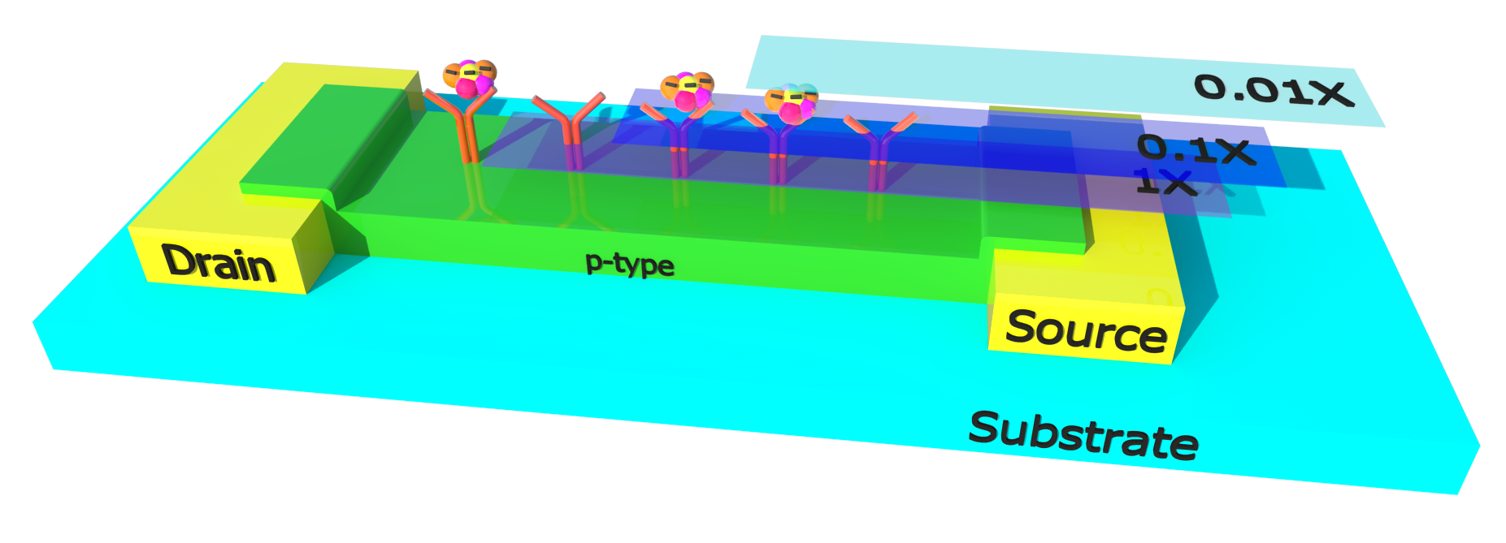
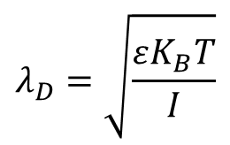
Debye Screening Length
Larger Debye length (7.3nm)
Smaller Debye length (2.3nm)

Slide 17
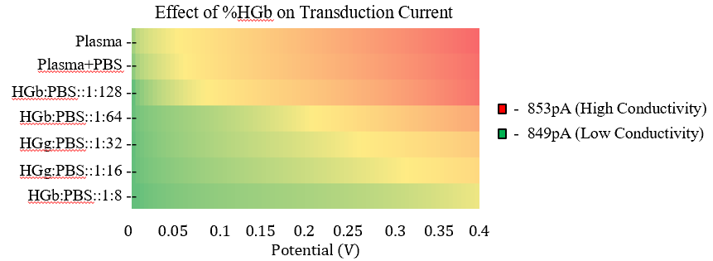
Effect of Hemolysis
HGb reconstituted from lyophilized powder
Δ 4pA from lowest to highest concentration
Negligible effect in nanoampere regime
Proposed mechanism: Nonpolar molecules solvate Fe ions

Slide 18
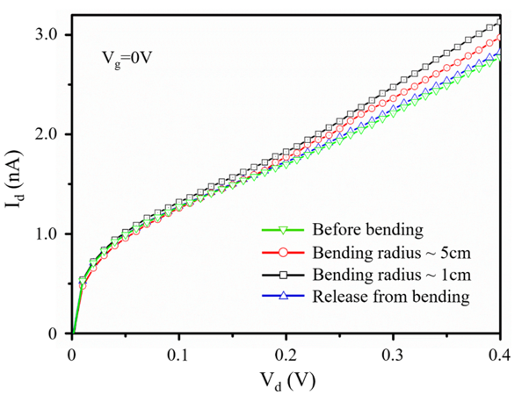
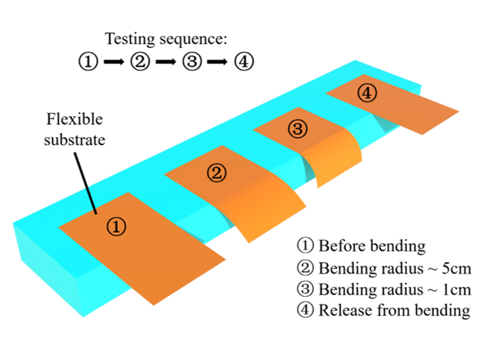
Flexibility and Restoration
None to highest flex resulted in ~10% amperage increase
X5 flex (1cm-5cm) resulted in ~5% amperage increase
Nearly complete restoration
Consistent patterning and linear effect

Slide 19
Testing and Analysis

Slide 20
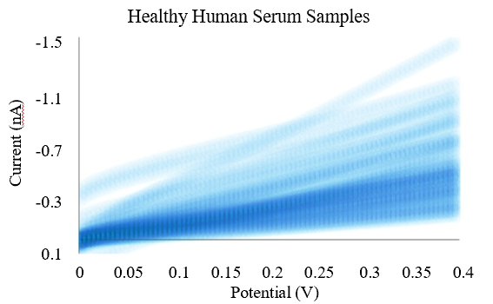
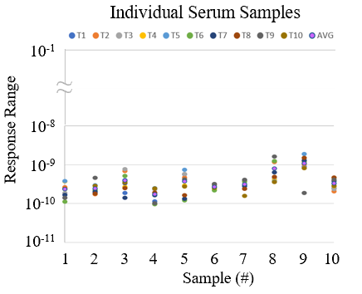
BNP in Healthy Individuals
10 samples x 10 devices x 80 measurements
Healthy [C] < 250pg, Unhealthy [C] > 800pg
Average 0.85nA range across 10 devices

Slide 21
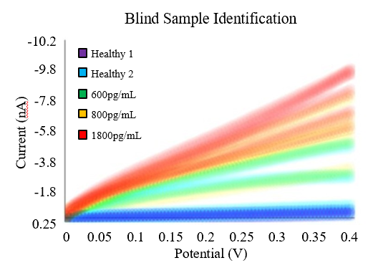
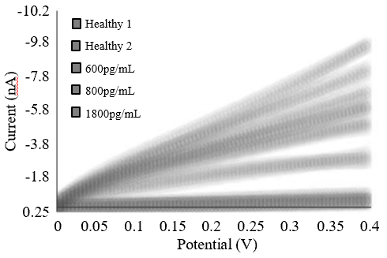
Comparison of BNP Levels
Healthy vs. Unhealthy
Signal response separate at 0.25V
Higher variation at higher concentrations
Clear delineation between healthy and unhealthy

Slide 22
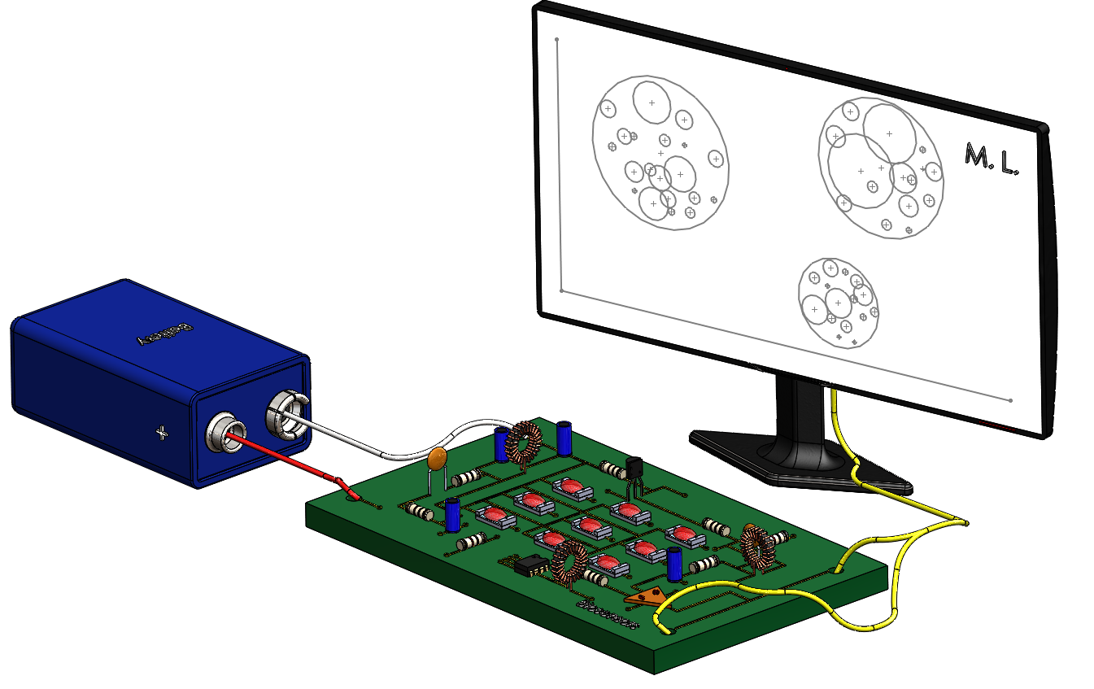
Data Classification
A.I. – a program that can both sense and react autonomously
M.L. – statistical algorithms and classifiers that improve with increased data exposure
D.L. – subset of M.L. that uses layered neural network to process data
Artificial Intelligence
Machine Learning
Deep Learning
M.L. to develop a health classifier with high predictive power
Determine At-Risk percentage of cardiac failure
Supplement sensor data with demographics information

Slide 23
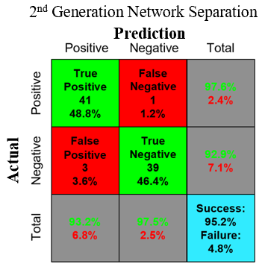
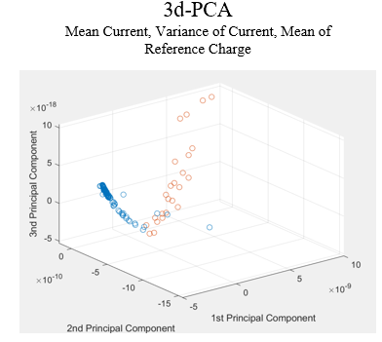
Machine Learning Analysis
Training set size n=15
Power – 96.4%, Accuracy – 95.2%
Statistical principal components, limited dimensionality

Slide 24
Future Work and Summary

Slide 25
Future work
Continue BNP characterization
Explore other biomarkers
Refine machine learning algorithm
Increase dimensionality
Create integrated circuit
Fabricate OLED’s on same chip
Qualitative and quantitative data

Slide 26
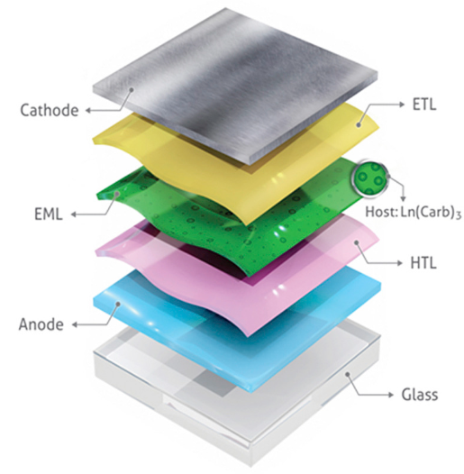
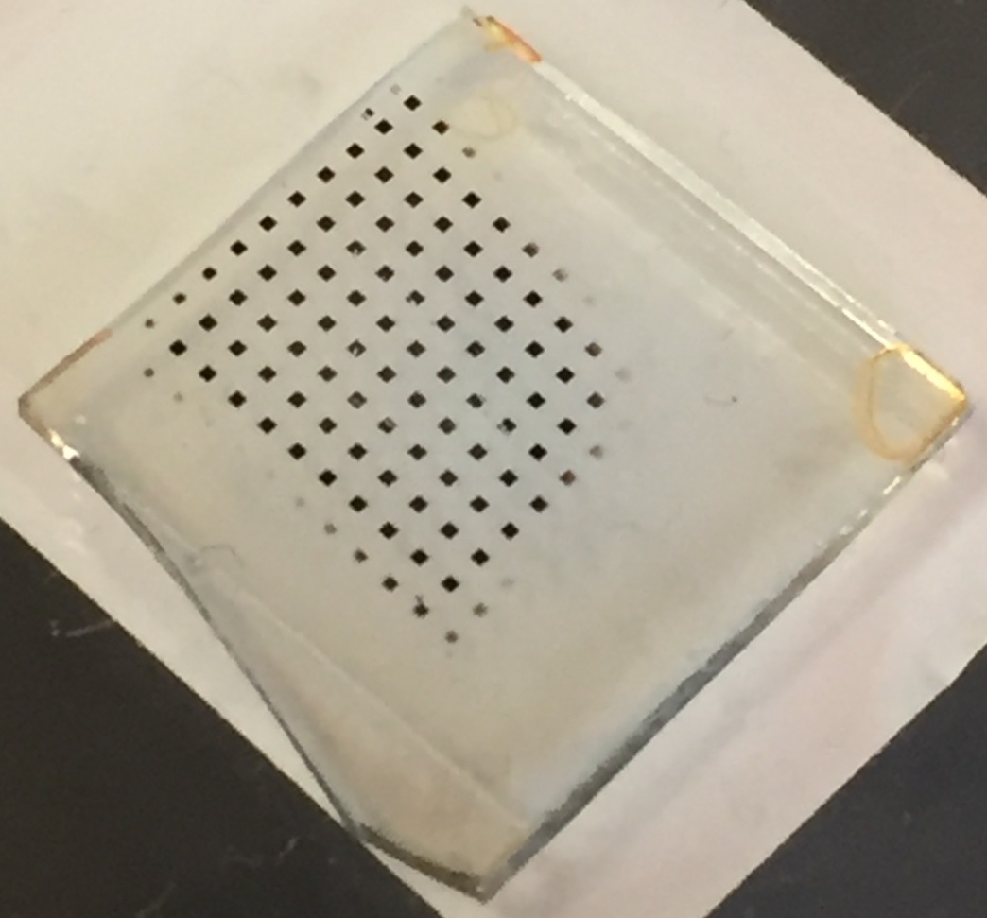
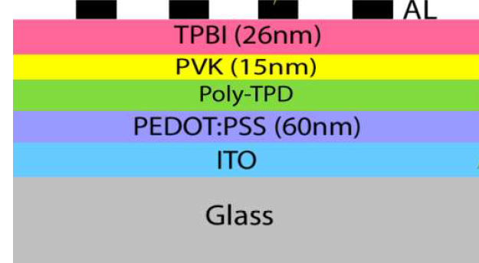
Future work - OLED Fabrication
Generic Form
Developed Recipe
Fabricated
Optimizing OLED turn on voltage and emissions
Replace glass with PET
Integrate OLED in series with biosensor

Slide 27
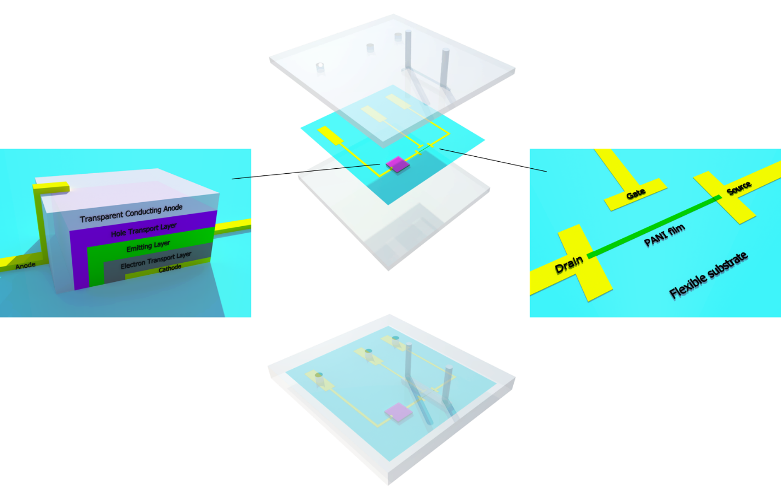
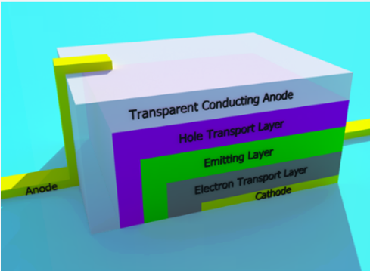
Future work - OLED Integration

Slide 28

Summary

Slide 29
Detection of B-Type Natriuretic Peptide (BNP) with Flexible Biosensors for Cardiovascular Risk Assessment

